Slide 1
Chapter - 4
Knowledge representation, inference and reasoning

Slide 2
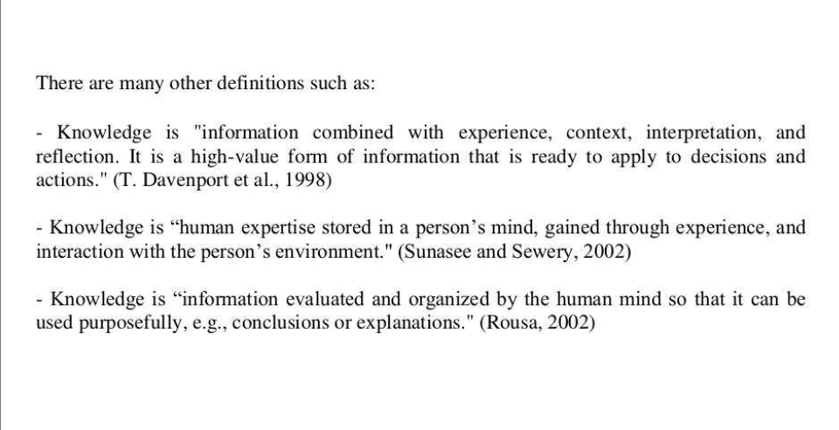
Knowledge is the information about a domain that can be used to solve problems in that domain.

Slide 3
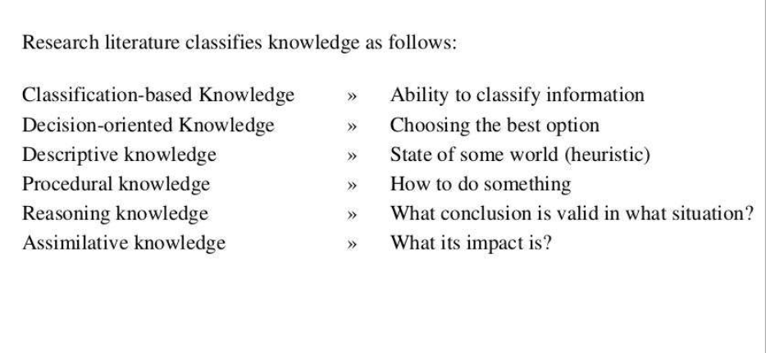

Slide 4
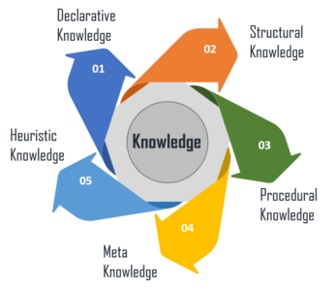
Types of Knowledge Representation

Slide 5
Declarative Knowledge – It includes concepts, facts, and objects and expressed in a declarative sentence.
Structural Knowledge – It is a basic problem-solving knowledge that describes the relationship between concepts and objects.
Procedural Knowledge – This is responsible for knowing how to do something and includes rules, strategies, procedures, etc.
Meta Knowledge – Meta Knowledge defines knowledge about other types of Knowledge.
Heuristic Knowledge – This represents some expert knowledge in the field or subject.

Slide 6
Knowledge Representation: Issues
Are any attributes of objects so basic that they have been occurred in almost every problem domain?
Are there any important relationships that exist among attributes of objects
At what level should knowledge be represented?
How should sets of objects be represented?
How can relevant parts be accessed when they are needed?

Slide 7
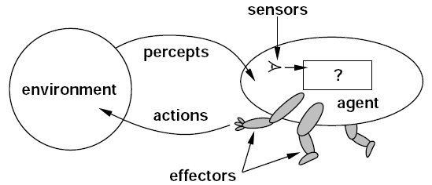
Knowledge Based Agent
An agent is anything that acts in environment.
In environments where we perfectly understand action-reaction pairs, we may say that an agent is rational when it chooses the action that will yield its desired outcome.
In an environment with any degree of uncertainty, we may say that an agent is rational if it acts in such a way that brings it the highest degree of expected desired outcomes.

Slide 8
Knowledge Based Agent: Levels of Knowledge Base
Knowledge Level
  The most abstract level
  Describes agent by saying what it knows
  Example:
    An intelligent taxi might know that the Bagmati Bridge connects Kathmandu with Lalitpur
Logical Level
  The level at which the knowledge is encoded into formal sentences
  Example:
    Joins(Bagmati bridge, Kathmandu, Lalitpur)
Implementation Level
  Physical representation of the sentences in the logical level
  Example:
    Objects, string, dams, etc.

Slide 9
Logic
Logic
Syntax: Formal standard to express sentences so that the sentences are well formed
Semantics: Has to do with the meaning of sentences
  Defines the truth of the sentences with respect to respective possible world
Connectives: Joins the different components of the sentence
Model and Real World
Entailment: the idea that a sentence follows logically from another sentence
  Example: α╞ β,where α & β are sentences and β follows from α

Slide 10
Logic
An inference algorithm that derives only entailed sentences is called sound or truth preserving
Completeness is desirable
  An inference algorithm is complete if it can derive any sentence that is
entailed
If knowledge base is true in the real world, then any sentence derived from the knowledge base by a sound inference procedure is also true in the real world

Slide 11
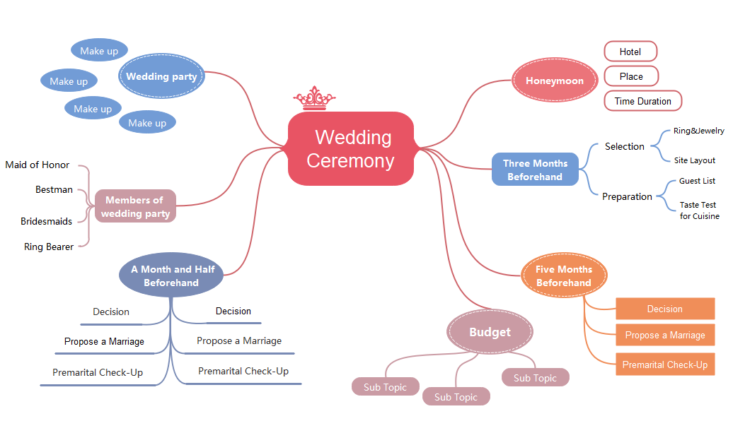

Slide 12
Logic
Example
Knowledge Base
  Socrates is a man
  All men are Mortal
  Äll men are kind
Inference algorithm is applied to the above base
Inferring “Socrates is Mortal”
“Socrates is kind” follows the sentence “All men are Kind

Slide 13
Truth Table
P | Q | !P | P^{V}Q | P^{Λ}Q
False | False | True | False | False
False | True | True | True | False
True | False | False | True | False
True | True | False | True | True

Slide 14
Tautology and Validity
A notation used in formal logic which is always true and valid.
Example:
A OR (NOT A)
I am eating food OR I am not eating food
If all the conditions for a statement is true its tautology
Tautologies are also called valid sentences

Slide 15
Knowledge Models
A model is a world in which a sentence is true under a particular interpretation
There can be several models at once that have the same interpretations
Types:
  First order logic
  Procedural Representation Model
  Relational Representation Model
  Hierarchical Representation Model
  Semantic Nets

Slide 16
Knowledge Models: Types
First Order Logic
  First Order Predicate Calculus
  Consists of objects, predicates on objects, connectives and quantifiers
  Predicates are the relations between objects or properties of the objects
  Connectives and quantifiers allow for universal sentences
  Relations between objects can be
true or false
Procedural Representation Model
  This model of knowledge representation encodes facts along with the sequence of operations for manipulation and processing of the facts
  Expert systems are based on this model
  It works best when experts follow set of procedures for problem solving
  Example: doctor making diagnosis

Slide 17
Knowledge Models: Types
Relational Representation Model
  Collection of knowledge are stored in tabular form
  Mostly used in commercial
databases, relational databases
  The information is manipulated with relational calculus use a language like SQL, Oracle, etc.
  Its flexible way of storing information by not good for storing complex relationships
Problem arises when more than one
subject area is attempted
A new knowledge base from scratch has to be built for each area of expertise
Hierarchical Representation Model
  Based on inherited knowledge and the relationship and shared attributes between objects

Slide 18
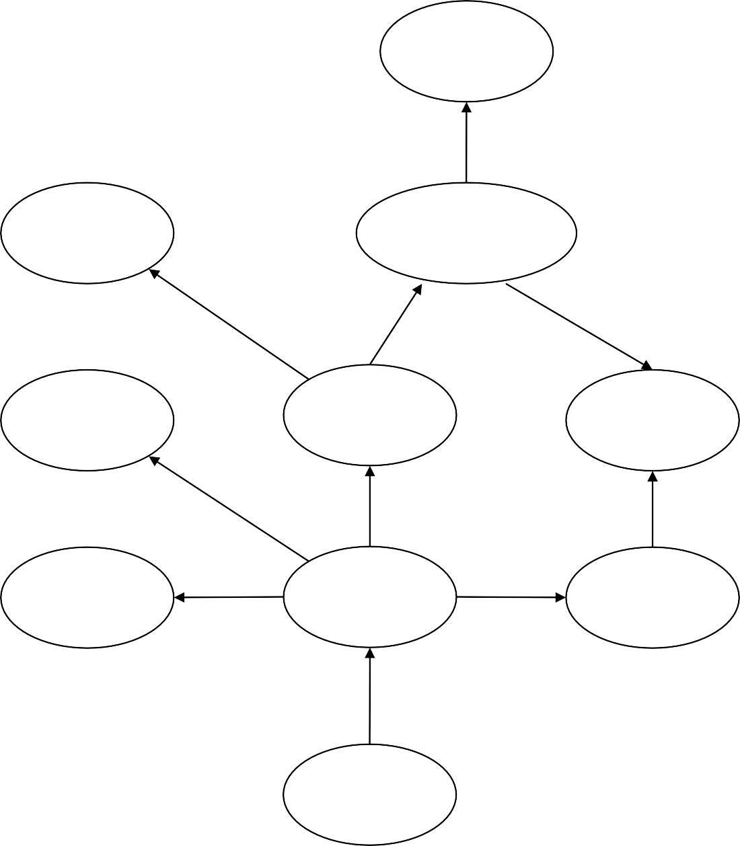
Knowledge Models: Types
Fur
Has
Semantic Nets
  Semantic networks are an alternative to predicate logic as a form of knowledge representation
  The idea is that we can store our knowledge in the form of graph with nodes representing objects in the world and are representing relationships between those objects
Mat
Mammal
Sat_on_a
Is_a
Is_a
Cream
Cat
Animal
Likes
Is_a
Is_a
Ate_a
Black
Tommy
Bird
Is
Owes
John

Slide 19
Propositional Logic
It is declarative sentences which can either be true or false but not both or neither
A Very simple logic
A Mathematical model that allows us to reason about the truth or falsehood of logical expressions
There are sentences and connectives to describe an expression
Its syntax defines allowable sentences
Example:
  Is it raining?
  Is 2+2=5?
Logical Connectives in Propositional Logic
  ˄ : Conjunction (and)
  ˅ : Disjunction (or)
  ˥ : Negation (not)
• ⁼> ➔ : Implication (if…then…)
  <⁼> ⬄ : Logical Equivalence (If and only If)

Slide 20
Propositional Logic: Truth Tables
A | ˥A
T | F
F | T
A | B | A˅B
F | F | F
F | T | T
T | F | T
T | T | T
A | B | A<⁼>B
F | F | T
F | T | F
T | F | F
T | T | T
A | B | A˄B
F | F | F
F | T | F
T | F | F
T | T | T
A | B | A⁼>B
F | F | T
F | T | F
T | F | T
T | T | T

Slide 21
Propositional Logic
Sentence Properties
  T or F itself is a sentence
  Individual Proposition symbols are sentences eg. P, Q, …
  If s is a sentence, so is (s)
  If S1 and S2 are sentences, so are:
˥S1, ˥S2, S1˄S2, etc.
Order of Precedence
  ˥ : Negation (not)
  ˄ : Conjunction (and)
  ˅ : Disjunction (or)
• ⁼> ➔ : Implication (if…then…)
Logical Equivalence (If and only If)
<⁼> ⬄ :

Slide 22
Propositional Logic
Atomic Sentences
  Single sentence
  T, F, P, Q,…
where, each symbol stands for proposition that can be true or false.
  Example: P=“Ram likes Rice”
Q=“Sita is women”
Complex Sentences
  Sentences constructed from simple sentences using logical connectives
  Example:P=“It is hot today”
Q=“It is humid today”
P^Q
“It is hot and humid today”

Slide 23
Propositional Logic
Unsatisfiable (Contradiction)
  If all the sentences or statements are always false
  Example: “There will be a clear sky
during rainy day”
Satisfiable
  If at least one sentence in the knowledge base is true

Slide 24
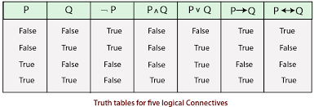

Slide 25
Propositional Logic: Equivalence Laws
1. P ⁼>Q Ξ ˥ P ˅ Q
2. P <⁼> Q Ξ (P ⁼> Q ) ˄ (Q ⁼> P)
Distributive Laws
A ˄ (B ˅ C) Ξ (A ˄ B) ˅ (A ˄ C)
A ˅ (B ˄ C) Ξ (A ˅ B) ˄ (A ˅ C)
De-Morgan’s Law
˥(A ˄ B ˄ C) Ξ (˥A) ˅ (˥B) ˅ (˥C)
˥(A ˅ B ˅ C) Ξ (˥A) ˄ (˥B) ˄ (˥C)

Slide 26
Propositional Logic: Inference Rules
1. Modus Ponen Rule
Whenever any sentence of the form P ⁼>Q and P are given, then the sentence Q can be inferred
P ⁼>Q, P
Example:
Statement-1: "If I am sleepy then I go to bed" ==> P→ Q
Statement-2: "I am sleepy" ==> P
Conclusion: "I go to bed." ==> Q.
Hence, we can say that, if P→ Q is true and P is true then Q will be true.
Q
2. Modus Tollens
Example:
Statement-1: "If I am sleepy then I go to bed" ==> P→ Q
Statement-2: "I do not go to the bed."==> ~Q
Statement-3: Which infers that "I am not sleepy" => ~P

Slide 27
3. Hypothetical Syllogism:
The Hypothetical Syllogism rule state that if P→R is true whenever P→Q is true, and Q→R is true. It can be represented as the following notation:
Example:
Statement-1: If you have my home key then you can unlock my home. P→Q
Statement-2: If you can unlock my home then you can take my money. Q→R
Conclusion: If you have my home key then you can take my money. P→R
4. Disjunctive Syllogism:
The Disjunctive syllogism rule state that if P∨Q is true, and ¬P is true, then Q will be true. It can be represented as:
Example:
Statement-1: Today is Sunday or Monday. ==>P∨Q
Statement-2: Today is not Sunday. ==> ¬P
Conclusion: Today is Monday. ==> Q

Slide 28
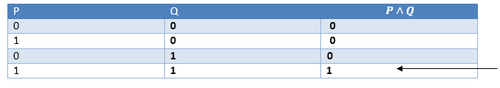
5. Addition:
The Addition rule is one the common inference rule, and it states that If P is true, then P∨Q will be true.
Example:
Statement: I have a vanilla ice-cream. ==> P
Statement-2: I have Chocolate ice-cream.
Conclusion: I have vanilla or chocolate ice-cream. ==> (P∨Q)
6. Simplification:
The simplification rule state that if P∧ Q is true, then Q or P will also be true. It can be represented as:

Slide 29
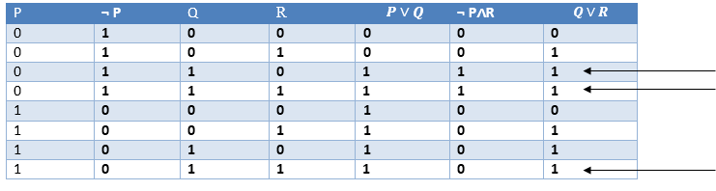
7. Resolution:
The Resolution rule state that if P∨Q and ¬ P∧R is true, then Q∨R will also be true. It can be represented as

Slide 30
Propositional Logic
The semantics defines the rules for determining the truth of sentences with respect to a particular model, i.e. semantic must specify how to compute the truth value of any sentence in a given model.

Slide 31
Propositional Logic: BNF Grammar
Backus Normal Form or Backus Naur Form
It’s a notation technique for context free grammars often used to describe the syntax of languages used in computing
BNF can be used in two ways:
  To generate strings belonging to the grammar
  To recognize strings belonging to
the grammar

Slide 32
Normal Forms of Propositional Logic Sentences
Conjunctive (disjunction of conjunction of literals) Normal Form
  In which a sentence is written as
the conjunction of literals (A ˅ B) ⁼>Q
Ξ ˥ (A ˅ B) ˅ Q
Ξ ( ˥ A ^ ˥ B) ˅ Q
Ξ ( ˥ A ˅ Q )^ (˥ B ˅ Q )
Disjunctive (conjunction of disjunction of literals) Normal Form
  In which a sentence is written as
the disjunction of literals ( A ^ Q ) ˅ ( B ^ Q )
Conjunctive normal form (CNF) is an approach to Boolean logic that expresses formulas as conjunctions of clauses with an AND or OR
CNF is useful for automated theorem proving.

Slide 33
First Order Predicate Logic (FOPL)
Propositional logic assumes that the world or system being modelled can be described in terms of fixed, known set of propositions
This assumption can make it awkward or even impossible to specify many pieces of knowledge
Example:
  Consider a general sentence “if a person is rich then they have a nice car”
  In propositional logic, we can generate rule for each person as
    Bob_is_rich → Bob_has_a_nice_car
    John_is_rich→John_has_a_nice_car
  This seems to be an impractical way to represent knowledge, hence, generalization to represent this type of knowledge is a must

Slide 34
First Order Predicate Logic (FOPL)
FOPL is a logic that gives us the ability to quantify over objects
In FOPL, statements from a natural language like English are translated into symbolic structure composed of predicates, functions, variables, constants, quantifiers and logical connectives
First Order Predicate Logic represents facts by separating classes and individuals and consider that world consists of different objects and relations between those objects

Slide 35
FOPL: Syntax
Sentence →
AtomicSentence Term →
AtomicSentence|(Sentence Connective Sentence)| Quantifier Variable,…Sentence| ˥Sentence
→ Predicate(Term,….)|Term = Term Function (Term,…) | Constant | Variable
˥|˅|˄|=>|<=>
Connective →
Quantifier →
Constant →
Variable →
Predicate →
Function →
E |A
A| X| John| … a | x | s| …
Before | HasColor | Raining | … Mother | Leftleg | …

Slide 36
FOPL: Syntax
Constant Symbols are the strings that will be interpreted as representing objects
Variable Symbols are used as place holders for quantifying over objects
Predicate symbols are used to denote properties of objects and relationship among them
Function Symbols map the specified number of input objects to objects
Quantifiers are used to quantify objects
  Universal Quantifier represents for all
  Existential Quantifier represents the existence of an object

Slide 37
FOPL: Variable Scope
The scope of the variable is in the sentence to which the quantifier syntactically applies
In a block structured programming language, a variable in a logical expression refers to the closest quantifier within whose scope it appears
In a well formed formula all the variables should be properly introduced

Slide 38
Relation Between Quantifiers
∀𝑥 ¬𝑃 | ≡ | ¬ ∃𝑥 𝑃
¬∀𝑥 𝑃 | ≡ | ∃𝑥 ¬𝑃
∀𝑥𝑃 ≡ ¬∃𝑥¬𝑃
∃𝑥𝑃 ≡ ¬∀𝑥¬𝑃
∀𝑥 𝑃 𝑥
∃𝑥 𝑃 𝑥
∩ 𝑄 𝑥 ≡ ∀𝑥 𝑃 𝑥 ∩ ∀𝑥 𝑄 𝑥
𝖴 𝑄 𝑥 ≡ ∃𝑥 𝑃 𝑥 𝖴 ∃𝑥 𝑄 𝑥

Slide 39
Examples
All birds can’t fly
∀𝑥 𝐵𝑖𝑟𝑑 𝑥 → ¬𝐹𝑙𝑦 𝑥
𝑂𝑅
¬(∃𝑥 (𝐵𝑖𝑟𝑑 𝑥 ∩ 𝐹𝑙𝑦 𝑥 )
Not all birds can fly
¬(∀𝑥 𝐵𝑖𝑟𝑑 𝑥 → 𝐹𝑙𝑦(𝑥))
If anyone can solve the problem then Raju can
∃𝑥𝑆𝑜𝑙𝑣𝑒𝑠 𝑥, 𝑝𝑟𝑜𝑏𝑙𝑒𝑚
→ 𝑆𝑜𝑙𝑣𝑒𝑠 𝑅𝑎𝑗𝑢, 𝑝𝑟𝑜𝑏𝑙𝑒𝑚

Slide 40
Equality
Can include equality as a primitive predicate in the logic or require it to be introduces and axiomitized as the identity relation
Useful in representing certain types of knowledge
  Example: Sita owns two cars
∃𝑥∃𝑦(𝑂𝑤𝑛𝑠 𝑆𝑖𝑡𝑎, 𝑥
∩ 𝑂𝑤𝑛𝑠 𝑆𝑖𝑡𝑎, 𝑦 ∩ 𝐶𝑎𝑟 𝑥
∩ 𝐶𝑎𝑟 𝑦 ∩ ¬ 𝑥 = 𝑦 )
Try these:
  There are exactly two purple flowers out of three
  Everyone is married to exactly one
person

Slide 41
Solution
There are exactly two purple |  | Everyone is married to exactly
flowers out of three |  | one person
∃𝑥∃𝑦𝑀𝑢𝑠ℎ𝑟𝑜𝑜𝑚 𝑥 ∩ 𝑀𝑢𝑠ℎ𝑟𝑜𝑜𝑚 𝑦 ∩ 𝑃𝑢𝑟𝑝𝑙𝑒 | 𝑥 | ∀𝑥∃𝑦𝑀𝑎𝑟𝑟𝑖𝑒𝑑 𝑥, 𝑦 ∩ ∀𝑧(𝑀𝑎𝑟𝑟𝑖𝑒𝑑 𝑥, 𝑧 ⇒ 𝑦 = 𝑧 )
∩ 𝑃𝑢𝑟𝑝𝑙𝑒 𝑦 ∩ ¬ 𝑥 = 𝑦
∩ ∀𝑧(𝑀𝑢𝑠ℎ𝑟𝑜𝑜𝑚 𝑧
∩ 𝑃𝑢𝑟𝑝𝑙𝑒 𝑧
⇒ 𝑥 = 𝑧
𝖴 𝑦 = 𝑧 )

Slide 42
Try few more
Ram likes all kinds of food
Anything anyone eats and is not killed by is food
Rita eats samosa and is still alive
Gita eats everything Rita eats
Someone who hates something owned by another person will not love that person
There is a barber in the town who shaves all men in the town who don’t shaves themselves
Everyone loves somebody
No one likes everyone
There is someone who is liked by everyone
You can fool some of the people every time
All employee earning Rs.200000|- or more per year pay taxes
Some employee are sick today
Nobody earns more than the chairman

Slide 43
Try few more: Solution
Ram likes all kinds of food
Anything anyone eats and is not killed by is food
Rita eats samosa and is still alive
Gita eats everything Rita eats
Someone who hates something owned by another person will not love that person
There is a barber in the town who shaves all men in the town who don’t shaves themselves
∀𝑥𝐹𝑜𝑜𝑑 𝑥 ⇒ 𝐿𝑖𝑘𝑒𝑠 Ram, 𝑥
∀𝑥∀𝑦𝐸𝑎𝑡𝑠 𝑥, 𝑦 ∩ ¬𝐾𝑖𝑙𝑙𝑒𝑑𝑏𝑦 𝑦, 𝑥
⇒ 𝑓𝑜𝑜𝑑 𝑥
𝐸𝑎𝑡𝑠 𝑅𝑖𝑡𝑎, 𝑆𝑎𝑚𝑜𝑠𝑎 ∩ 𝐴𝑙𝑖𝑣𝑒 𝑅𝑖𝑡𝑎
∀𝑥𝐸𝑎𝑡𝑠 𝑅𝑖𝑡𝑎, 𝑥 ⇒ 𝐸𝑎𝑡𝑠 𝐺𝑖𝑡𝑎, 𝑥
∃𝑥∃𝑦∃𝑧𝑂𝑤𝑛𝑠 𝑥, 𝑧 ∩ 𝐻𝑎𝑡𝑒𝑠 𝑦, 𝑧
⇒ 𝐻𝑎𝑡𝑒𝑠 𝑦, 𝑥
∃𝑥(𝐵𝑎𝑟𝑏𝑒𝑟 𝑥
∩ ∀𝑦𝑀𝑎𝑛 𝑦
∩ ¬𝑆ℎ𝑎𝑣𝑒𝑠 𝑦, 𝑦
∩ 𝐼𝑛𝑡𝑜𝑤𝑛 𝑥
∩ 𝐼𝑛𝑡𝑜𝑤𝑛 𝑦
⇒ 𝑆ℎ𝑎𝑣𝑒𝑠(𝑥, 𝑦)

Slide 44
Try few more: Solution
Everyone loves somebody
No one likes everyone
There is someone who is liked by everyone
You can fool some of the people every time
All employee earning Rs.200000|- or more per year pay taxes
Some employee are sick today
Nobody earns more than the chairman
∀𝑥∃𝑦𝐿𝑜𝑣𝑒𝑠 𝑥, 𝑦
¬∃𝑥∀𝑦𝐿𝑖𝑘𝑒𝑠 𝑥, 𝑦 ≡ ∀𝑥∃𝑦¬𝐿𝑖𝑘𝑒𝑠 𝑥, 𝑦
∃𝑦∀𝑥𝐿𝑖𝑘𝑒𝑠 𝑥, 𝑦
∃𝑥∀𝑦𝑃𝑒𝑟𝑠𝑜𝑛 𝑥 ∩ 𝑇𝑖𝑚𝑒 𝑦
⇒ 𝐶𝑎𝑛𝑏𝑒𝑓𝑜𝑜𝑙𝑒𝑑 𝑥, 𝑡
∀𝑥𝐸𝑚𝑝𝑙𝑜𝑦𝑒𝑒 𝑥
∩ 𝐸𝑎𝑟𝑛𝑚𝑜𝑟𝑒𝑡ℎ𝑎𝑛 𝑥, 200000
⇒ 𝑃𝑎𝑦𝑡𝑎𝑥 𝑥
∃𝑥𝐸𝑚𝑝𝑙𝑜𝑦𝑒𝑒 𝑥 ⇒ 𝑆𝑖𝑐𝑘 𝑥
∀𝑥𝐸𝑚𝑝𝑙𝑜𝑦𝑒𝑒 𝑥
⇒ ¬𝐸𝑎𝑟𝑛𝑚𝑜𝑟𝑒𝑡ℎ𝑎𝑛(𝑥, 𝑆𝑎𝑙𝑎𝑟𝑦 𝐶ℎ𝑎𝑖𝑟𝑚𝑎𝑛 )

Slide 45
Inference in FOL
Mapping in FOL
∀𝑥∀𝑦 𝑝𝑎𝑟𝑒𝑛𝑡 𝑥, 𝑦 ⇒
𝑜𝑙𝑑𝑒𝑟 𝑥, 𝑦
∀𝑥∀𝑦 𝑚𝑜𝑡ℎ𝑒𝑟 𝑥, 𝑦 ⇒
𝑝𝑎𝑟𝑒𝑛𝑡 𝑥, 𝑦
𝑚𝑜𝑡ℎ𝑒𝑟 𝐷𝑒𝑣𝑎𝑘𝑖, 𝐾𝑟𝑖𝑠ℎ𝑛𝑎
Conclusion:
older(Devaki,Krishna)
If x is a parent of y, then x is older than y
If x is the mother of y then x is a parent of y
Devaki is the mother of Krishna
Conclusion:
Devaki is older than Krishna

Slide 46
Inference Rules in FOL
Universal Instantiation
  If a person is a student, studies in ACEM and studies AI, then he/she is a third year student
  ∀𝑥𝑠𝑡𝑢𝑑𝑒𝑛𝑡 𝑥 ∩
𝑠𝑡𝑢𝑑𝑖𝑒𝑠𝑖𝑛 𝑥, ACEM ∩
𝑠𝑡𝑢𝑑𝑖𝑒𝑠 𝑥, 𝐴𝐼 ⇒
𝑡ℎ𝑖𝑟𝑑𝑦𝑒𝑎𝑟𝑠𝑡𝑢𝑑𝑒𝑛𝑡(𝑥)
If a person is a teacher, who teach in ACEM and teach AI, then he/she is teacher who teach in third year
Existential Instantiation
  There must be a topper in ACEM
  ∃𝑥𝑠𝑡𝑢𝑑𝑒𝑛𝑡 𝑥 ∩
𝑠𝑡𝑢𝑑𝑖𝑒𝑠𝑖𝑛 𝑥, ACEM ∩ 𝑡𝑜𝑝𝑝𝑒𝑟 𝑥
Propositionization
  All people are kind
∀𝑥𝑝𝑒𝑟𝑠𝑜𝑛 𝑥 ⇒ 𝑘𝑖𝑛𝑑 𝑥
It can be inferred as
𝑝𝑒𝑟𝑠𝑜𝑛 𝑅𝑎𝑚 ⇒ 𝑘𝑖𝑛𝑑(𝑅𝑎𝑚)

Slide 47
Inference Rules in FOL
Generalized Modus Ponens
Unification
  [𝑘𝑛𝑜𝑤𝑠 𝑆𝑖𝑡𝑎, 𝑥 ,
∀𝑥𝑠𝑡𝑢𝑑𝑒𝑛𝑡 𝑥 ∩
𝑠𝑡𝑢𝑑𝑖𝑒𝑠ℎ𝑎𝑟𝑑 𝑥 ⇒
𝑔𝑜𝑜𝑑 𝑠𝑡𝑢𝑑𝑒𝑛𝑡 𝑥
𝑠𝑡𝑢𝑑𝑒𝑛𝑡 𝐴𝑟𝑗𝑢𝑛
𝑠𝑡𝑢𝑑𝑖𝑒𝑠ℎ𝑎𝑟𝑑 𝐴𝑟𝑗𝑢𝑛
Conclusion:
𝑔𝑜𝑜𝑑𝑠𝑡𝑢𝑑𝑒𝑛𝑡(𝐴𝑟𝑗𝑢𝑛)

